Slide 1
Music Genre Classification
Afrina fardous
1512009042
Cse-465 section-02

Slide 2
Our dataset
We used public GTZAN dataset.
The Dataset consists of 10 genre classes each including 100 .wav files
The classes are:
Blues
Classical
Country
Disco
Hip-hop
Jazz
Metal
Pop
Reggae
Rock

Slide 3
Method
Convolutional Neural Network with Architecture CNN-2D

Slide 4
Features Extraction for SVM
Using Librosa library we calculated the features of
centeroid
roloff
zcr
rms and
flux
And for each feature we calculated
mean
std
kurtosis and
skew
We did mfcc treatment and calculated tempo.
After computing our feature shape was (1000,74)

Slide 5
Features Extraction for cnn-2d
Split a 30s song into 3 songs with 50% overlapping
Converted the list of songs into an np array of melspectograms

Slide 6
DATASET SPLIT
The size of X-shape was (19000, 128, 129, 3)
The size of Y-shape was (19000, 10)
The ratio of training and testing set was 70:30
After splitting the shape of training and testing was
X-Train-Shape (13300, 128, 129, 3)
X-Test-Shape (5700, 128, 129, 3)
Y-Train-Shape (13300, 10)
Y-Test-Shape (5700, 10)

Slide 7
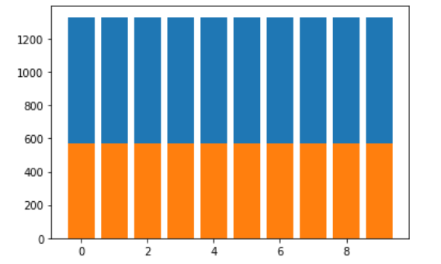
Histogram of train and test set

Slide 8
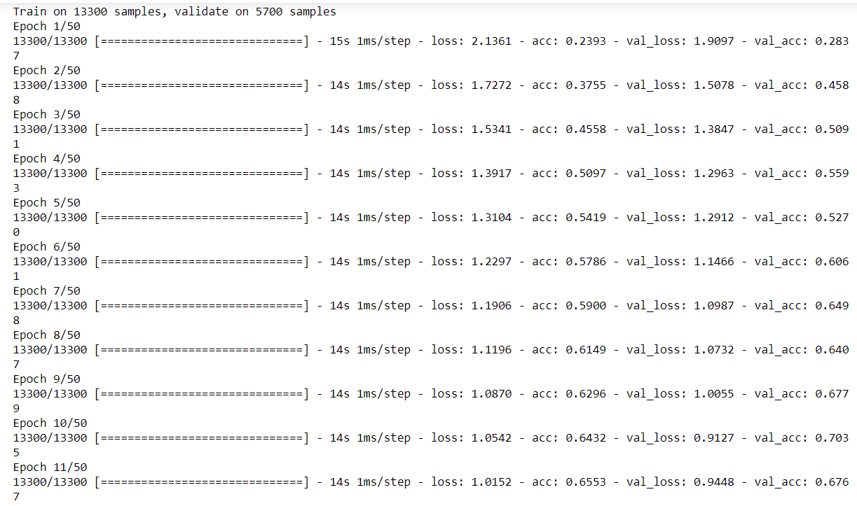
Training
For training:
The batch size was – 32
And we trained for – 50 epochs

Slide 9
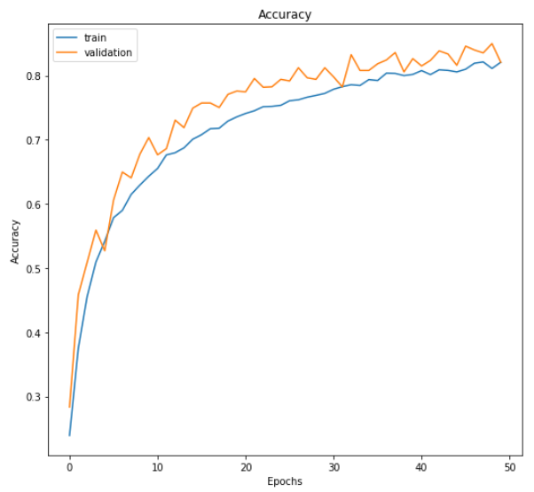
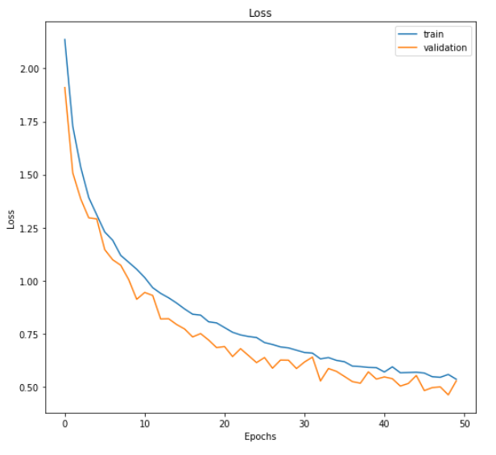
Accuracy
Validation Loss = 0.528
Validation accuracy = 0.821

Slide 10
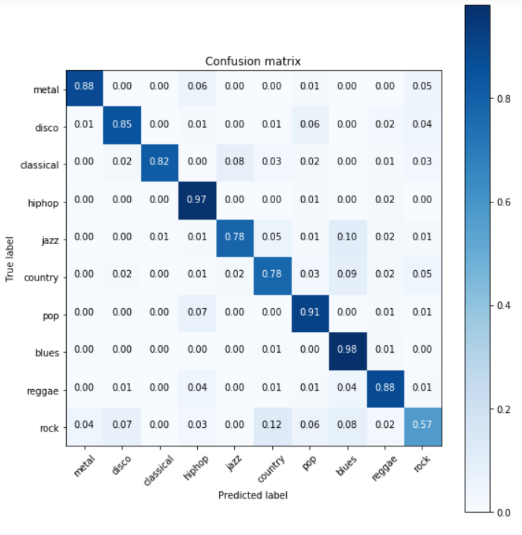
Confusion matrix for cnn-2d

Slide 11
Future work
So far we applied classical machine learning and neural network approaches to classify the genres of music.
Using CNN-2D architecture of CNN we got accuracy 82% whereas using Logistic Regression we got accuracy only 72%
For future work our plan is to build a real-time classifier to classify music genres.

